Slide 1






Analysis of Mental Health in Tech

Slide 2
Overview
Survey measures
Attitudes toward mental health
Frequency of mental health disorders
Demographic information collected
Age
Gender
Family history of mental health disorders
Country
State (for respondents residing in the US)

Slide 3

Survey Results

Slide 4
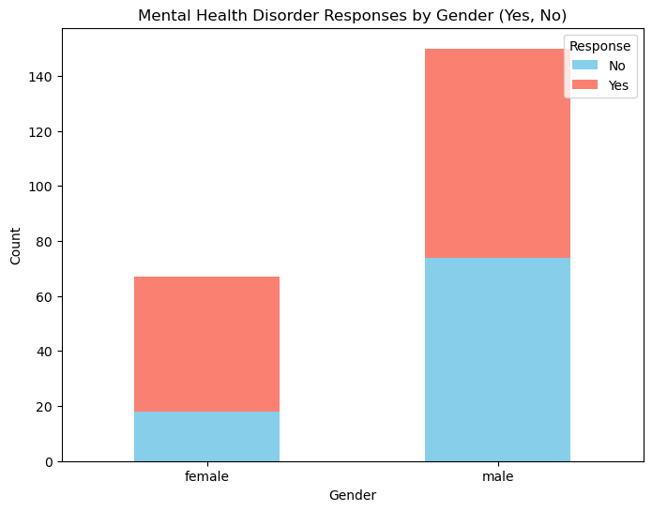
Mental Health in Tech: Gender

Slide 5
Mental Health in Tech: Gender

Slide 6
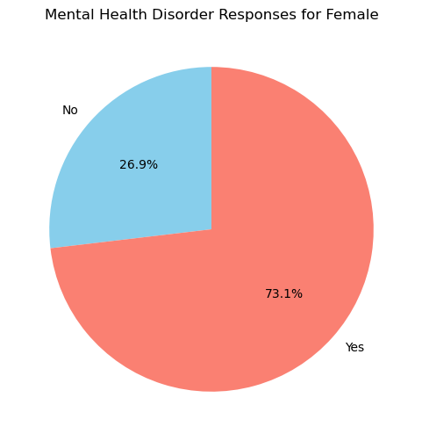
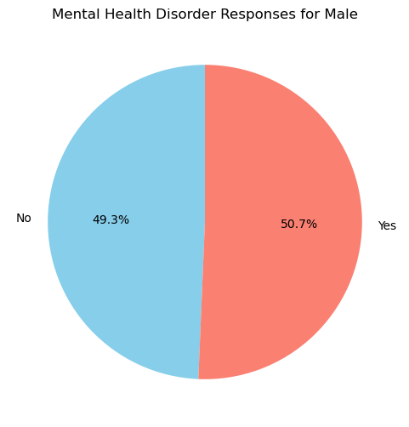
Mental Health in Tech: Gender

Slide 7
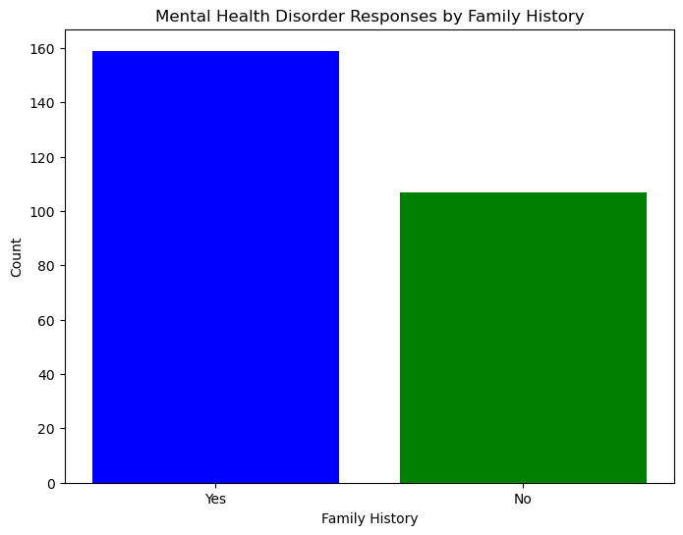
Mental Health Family History

Slide 8
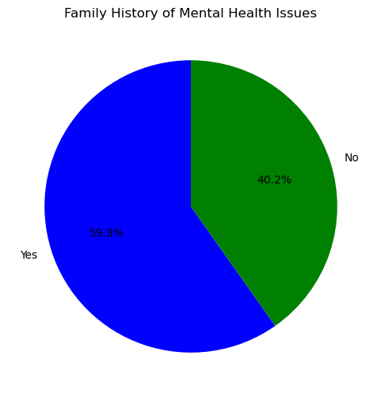
Mental Health Family History

Slide 9
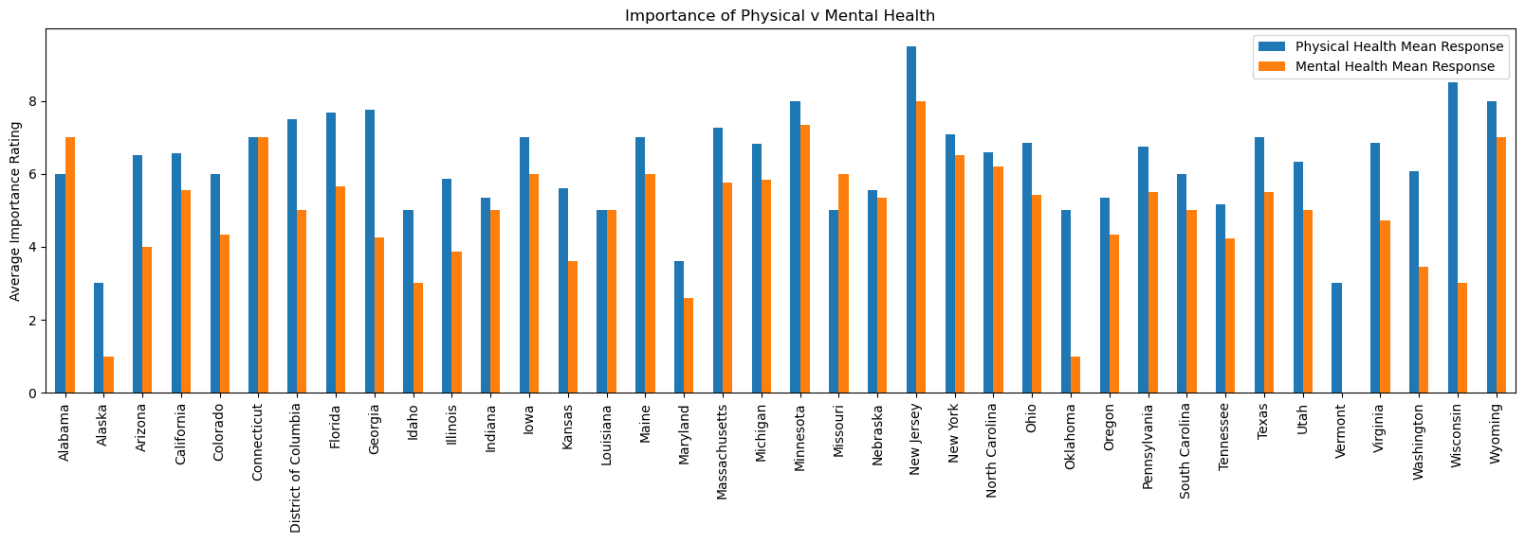
Mental Health in Tech: Geography Relative Importance of Physical Health v Mental Health by State

Slide 10
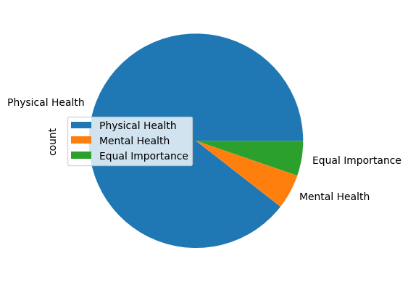
Relative Importance of Physical Health v Mental Health
90% of tech employers prioritize physical health over mental health.

Slide 11
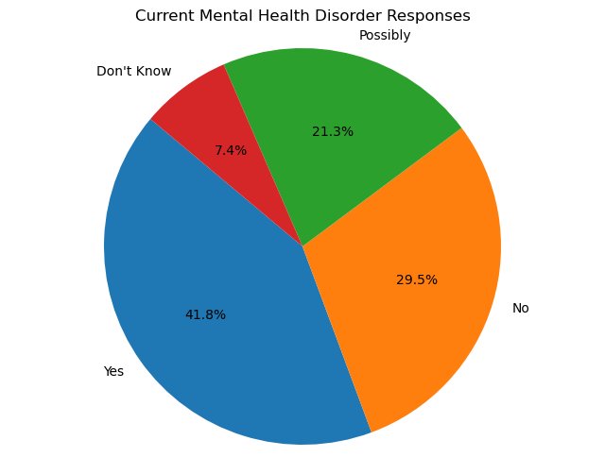
Mental Health in Tech: Respondents with Disorders
63% had a disorder or thought it was possible they had disorder

Slide 12
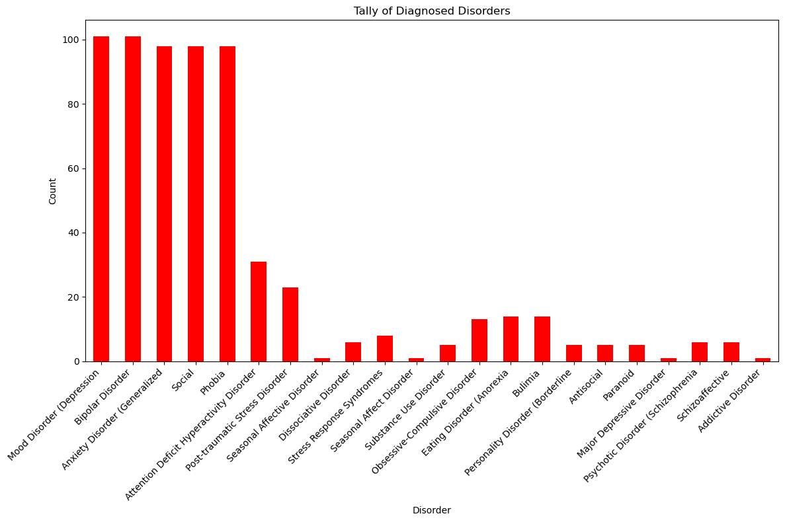
Mental Health in Tech: Common Disorders
Mood Disorder
Bipolar Disorder
Anxiety Disorder
Social
Phobia

Slide 13
Conclusions

Slide 14
Findings
The female respondents reported mental health disorders at a higher rate than their male counterparts
More than half the respondents reported a family history of mental health disorders
An overwhelming number of the respondents felt their employers prioritized physical health over mental health.

Slide 15
Top 5 Reported Disorders
Mood Disorder
Bipolar Disorder
Anxiety Disorder
Social
Phobia

Slide 16

The End
Presented by:
Erik Fraas
Sebastian Lopez
Andrea Hazzard
Jamie Stark

